Slide 1
Software Testing and Quality Assurance
Theory and Practice
Chapter 1
Basic Concepts and Preliminaries
Notes:
------------------------------------------------------------------
------------------------------------------------------------------
-------------------------------------------------------------------
--------------------------------------------------------------------

Slide 2
Outline of the Chapter
The Quality Revolution
Software Quality
Role of Testing
Verification and Validation
Failure, Error, Fault and Defect
The Notion of Software Reliability
The Objectives of Testing
What is a Test Case?
Expected Outcome
The Concept of Complete Testing
The Central Issue in Testing
Testing Activities
Testing Level
Source of Information for Test Selection
White-box and Black-box Testing
Test Planning and Design
Monitoring and Measuring Test Execution
Test Tools and Automation
Test Team Organization and Management

Slide 3
The Quality Revolution
Started in Japan by Deming, Juran, and Ishikawa during 1940s
In 1950s, Deming introduced statistical quality control to Japanese engineers
Statistical quality control (SQC) is a discipline based on measurement and statistics
  SQC methods use seven basic quality management tool
    Pareto analysis, Trend Chart, Flow chart, Histogram, Scatter diagram, Control chart, Cause and effect diagram
“Lean principle” was developed by Taiichi Ohno of Toyota
  “A systematic approach to identifying and eliminating waste through continuous improvement, flowing the product at the pull of the customer in pursuit of perfection.”

Slide 4
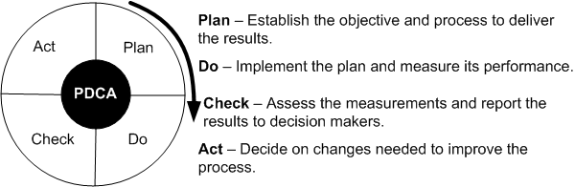
The Quality Revolution
Figure 1.1: The Shewhart cycle
Deming introduced Shewhart’s PDCA cycle to Japanese researchers
It illustrate the activity sequence:
  Setting goals
  Assigning them to measurable milestones
  Assessing the progress against the milestones
  Take action to improve the process in the next cycle

Slide 5
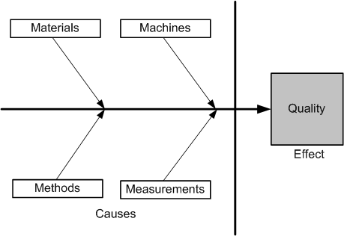
The Quality Revolution
In 1954, Juran spurred the move from SQC to TQC (Total Quality Control)
Key Elements of TQC:
  Quality comes first, not short-term profits
  The customer comes first, not the producer
  Decisions are based on facts and data
  Management is participatory and respectful of all employees
  Management is driven by cross-functional committees
An innovative methodology developed by Ishikawa called cause-and-effect diagram
Figure 1.2: Ishikawa diagram

Slide 6
The Quality Revolution
National Broadcasting Corporation (NBC) of United States broadcast a documentary
  “If Japan Can ... Why Can’t We?” on June 24th, 1980
Leaders in United States started emphasizing on quality
In 1987 Malcolm Baldrige National Quality Award was introduced in U.S.A
  Similar to the Deming prize in Japan
In Baldrige National Award the quality is viewed as:
  Something defined by the customer
In Deming prize, the quality is viewed as:
  Something defined by the producer by conformance to specifications

Slide 7
Software Quality
Five Views of Software Quality:
  Transcendental view
  User’s view
  Manufacturing view
  Product view
  Value-based view
Software Quality in terms of quality factors and criteria
  A quality factor represents behavioral characteristic of a system
    Examples: correctness, reliability, efficiency, and testability
  A quality criterion is an attribute of a quality factor that is related to software development
    Example: modularity is an attribute of software architecture
Quality Models
  Examples: ISO 9126, CMM, TPI, and TMM

Slide 8
Role of Testing
Software quality assessment divide into two categories:
  Static analysis
    It examines the code and reasons over all behaviors that might arise during run time
      Examples: Code review, inspection, and algorithm analysis
  Dynamic analysis
    Actual program execution to expose possible program failure
    One observe some representative program behavior, and reach conclusion about the quality of the system
Static and Dynamic Analysis are complementary in nature
Focus is to combines the strengths of both approaches

Slide 9
Verification and Validation
Verification
  Evaluation of software system that help in determining whether the product of a given development phase satisfy the requirements established before the start of that phase
    Building the product correctly
Validation
  Evaluation of software system that help in determining whether the product meets its intended use
    Building the correct product

Slide 10
Failure, Error, Fault and Defect
Failure
  A failure is said to occur whenever the external behavior of a system does not conform to that prescribed in the system specification
Error
  An error is a state of the system.
  An error state could lead to a failure in the absence of any corrective action by the system
Fault
  A fault is the adjudged cause of an error
Defect
  It is synonymous of fault
  It a.k.a. bug

Slide 11
The Notion of Software Reliability
It is defined as the probability of failure-free operation of a software system for a specified time in a specified environment
It can be estimated via random testing
Test data must be drawn from the input distribution to closely resemble the future usage of the system
Future usage pattern of a system is described in a form called operational profile

Slide 12
The Objectives of Testing
It does work
It does not work
Reduce the risk of failures
Reduce the cost of testing

Slide 13
What is a Test Case?
Test Case is a simple pair of
  <input, expected outcome>
State-less systems: A compiler is a stateless system
  Test cases are very simple
    Outcome depends solely on the current input
State-oriented: ATM is a state oriented system
  Test cases are not that simple. A test case may consist of a sequences of <input, expected outcome>
    The outcome depends both on the current state of the system and the current input
    ATM example:
        < check balance, $500.00 >,
        < withdraw, “amount?” >,
        < $200.00, “$200.00” >,
        < check balance, $300.00 >

Slide 14
Expected Outcome
An outcome of program execution may include
  Value produced by the program
  State Change
  A sequence of values which must be interpreted together for the outcome to be valid
A test oracle is a mechanism that verifies the correctness of program outputs
  Generate expected results for the test inputs
  Compare the expected results with the actual results of execution of the IUT

Slide 15
The Concept of Complete Testing
Complete or exhaustive testing means
  “There are no undisclosed faults at the end of test phase”
Complete testing is near impossible for most of the system
  The domain of possible inputs of a program is too large
    Valid inputs
    Invalid inputs
  The design issues may be too complex to completely test
  It may not be possible to create all possible execution environments of the system

Slide 16
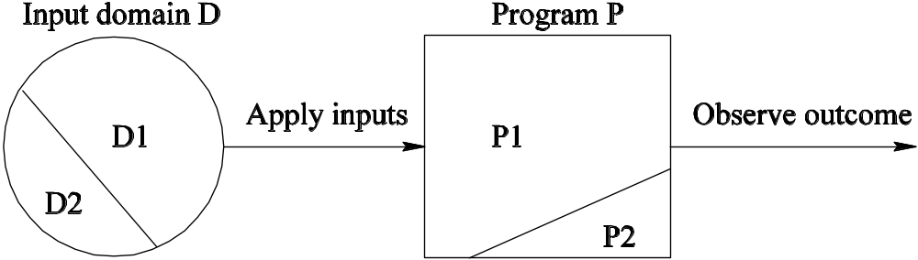
The Central Issue in Testing
Figure 1.5: A subset of the input domain exercising a subset of the program behavior
Divide the input domain D into D1 and D2
Select a subset D1 of D to test program P
It is possible that D1 exercise only a part P1 of P

Slide 17
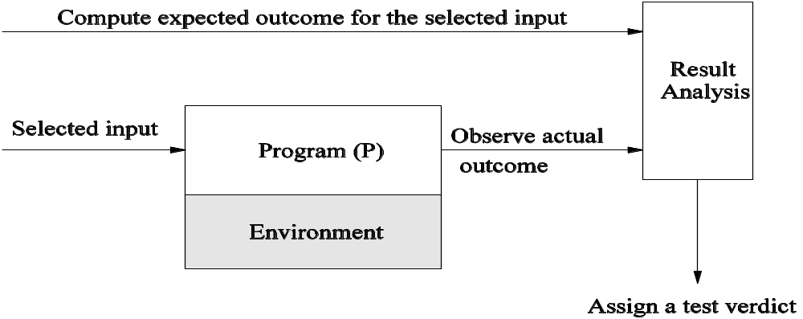
Testing Activities
Figure 1.6: Different activities in process testing
Identify the objective to be tested
Select inputs
Compute the expected outcome
Set up the execution environment of the program
Execute the program
Analyze the test results

Slide 18
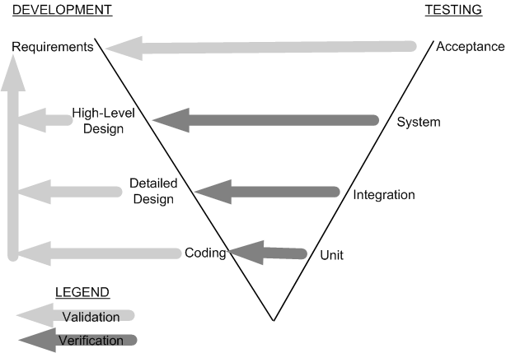
Testing Level
Unit testing
  Individual program units, such as procedure, methods in isolation
Integration testing
  Modules are assembled to construct larger subsystem and tested
System testing
  Includes wide spectrum of testing such as functionality, and load
Acceptance testing
  Customer’s expectations from the system
  Two types of acceptance testing
    UAT
    BAT
  UAT: System satisfies the contractual acceptance criteria
  BAT: System will eventually pass the user acceptance test
Figure 1.7: Development and testing phases in the V model

Slide 19
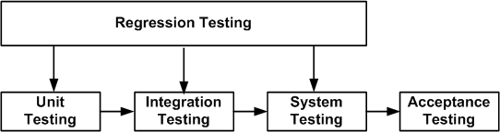
Testing Level
Figure 1.8: Regression testing at different software testing levels
New test cases are not designed
Test are selected, prioritized and executed
To ensure that nothing is broken in the new version of the software

Slide 20
Source of Information for Test Selection
Requirement and Functional Specifications
Source Code
Input and output Domain
Operational Profile
Fault Model
  Error Guessing
  Fault Seeding
  Mutation Analysis

Slide 21
White-box and Black-box Testing
White-box testing a.k.a. structural testing
Examines source code with focus on:
  Control flow
  Data flow
Control flow refers to flow of control from one instruction to another
Data flow refers to propagation of values from one variable or constant to another variable
It is applied to individual units of a program
Software developers perform structural testing on the individual program units they write
Black-box testing a.k.a. functional testing
Examines the program that is accessible from outside
Applies the input to a program and observe the externally visible outcome
It is applied to both an entire program as well as to individual program units
It is performed at the external interface level of a system
It is conducted by a separate software quality assurance group

Slide 22
Test Planning and Design
The purpose is to get ready and organized for test execution
A test plan provides a:
  Framework
    A set of ideas, facts or circumstances within which the tests will be conducted
  Scope
    The domain or extent of the test activities
  Details of resource needed
  Effort required
  Schedule of activities
  Budget
Test objectives are identified from different sources
Each test case is designed as a combination of modular test components called test steps
Test steps are combined together to create more complex tests

Slide 23
Monitoring and Measuring Test Execution
Metrics for monitoring test execution
Metrics for monitoring defects
Test case effectiveness metrics
  Measure the “defect revealing ability” of the test suite
  Use the metric to improve the test design process
Test-effort effectiveness metrics
  Number of defects found by the customers that were not found by the test engineers

Slide 24
Test Tools and Automation
Increased productivity of the testers
Better coverage of regression testing
Reduced durations of the testing phases
Reduced cost of software maintenance
Increased effectiveness of test cases
The test cases to be automated are well defined
Test tools and an infrastructure are in place
The test automation professionals have prior successful experience in automation
Adequate budget have been allocation for the procurement of software tools

Slide 25
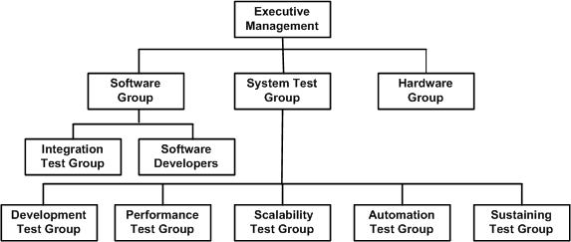
Test Team Organization and Management
Figure 16.1: Structure of test groups
Hiring and retaining test engineers is a challenging task
Interview is the primary mechanism for evaluating applicants
Interviewing is a skills that improves with practice
To retain test engineers management must recognize the importance of testing efforts at par with development effort

